Slide 1
205 Fri Oct 18, Class 10
Levav & Argo (2010)
Discussion of Experiment 2
Interpreting data from factorial designs, part 1

Slide 2
Choosing where to sit
In a study of interpersonal closeness, researchers primed either independence or interdependence by writing out reasons why they thought of themselves as similar or different from their close friends and family.
Participants were then were asked to take a seat in a waiting area full of chairs where a jacket indicated the presence of another person.
Data from men and women in the study were considered separately
The dependent variable measured was the number of chairs between the jacket and the chosen seat.

Slide 3
 | Men | Women
Independent
Interdepdendent
6.1
4.5
4.3
2.7

Slide 4

Levav & Argo (2010)

Slide 5
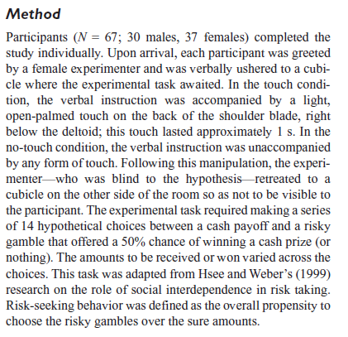
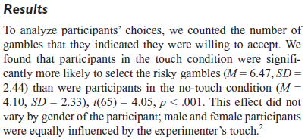
Design, Experiment 1

Slide 6
Assignment Question 1
Experiment 1 is a simple two group study.
The procedure for implementing the independent variable is described as “In the touch condition, the verbal instruction was accompanied by a light, open-palmed touch on the back of the shoulder blade, right below the deltoid; this touch lasted approximately 1 s. In the no-touch condition, the verbal instruction was unaccompanied by any form of touch. Following this manipulation, the experimenter — who was blind to the hypothesis—retreated to a cubicle on the other side of the room so as not to be visible to the participant.”
Why does this operational definition of “touch” need such an elaborate description?

Slide 7
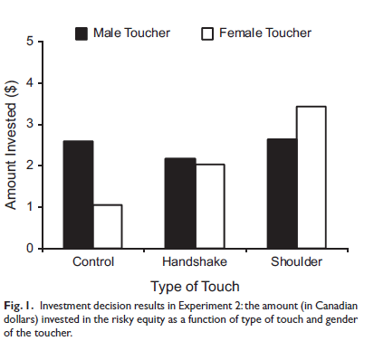
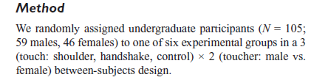
Experiment 2

Slide 8
Assignment Questions 2-5
Experiment 2 uses a factorial design. How many factors are there and how many levels of each factor?
What is the dependent variable in Experiment 2?
List the hypotheses tested by this design.
What kind of interaction is shown in Figure 4 (Experiment 3)

Slide 9

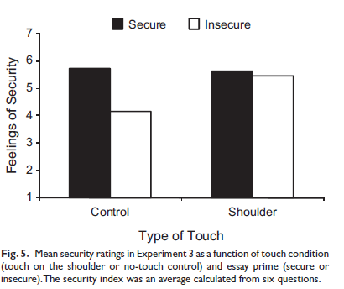
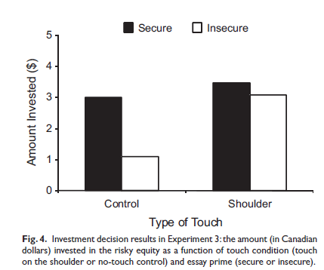
Experiment 3
Operational definition, Security:
We primed feelings of security or insecurity in a laboratory room by having participants write a brief essay about a time in their life when they “felt secure and supported” (secure-essay condition) or a time in their life when they “felt insecure and alone” (insecure-essay condition).

Slide 10
Experiment 2
Memory for pictures/images
  Usually very good
  “Picture superiority” effect
How does “deep encoding” work?
How would this process be affected by more or less meaningful pictures?

Slide 11


Slide 12
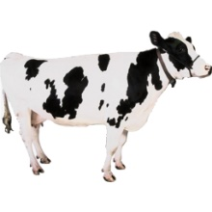

Slide 13


Slide 14


Slide 15
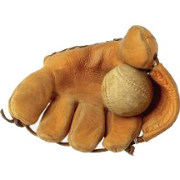

Slide 16
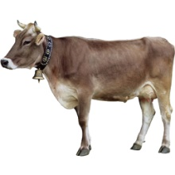

Slide 19
Operational definitions
Deep?
Shallow?

Slide 20
Factorial diagram
 |  | Type of Picture
 |  | Meaningful | Abstract
Type of Study | Deep
 | Shallow

Slide 21
Chapter 10: Factorial design outcomes
1 main effect
  Or the other main effect
2 main effects with no interaction
  Effects add up
Super-additive interaction
  Bigger effect in one condition
3:1 interaction
  Little to no effect in one condition
Cross-over interaction
  Effect inverts across conditions

Slide 22
Patterns of Results in 2x2 Designs
Simulated data
Factor 1 has two levels
  Condition A, Condition B
Factor 2 has two levels
  Condition X, Condition Y
Dependent variable is a measure on a 10-point scale
20 participants per condition

Slide 23
Data in a Means Table
Means Table |  | Factor 1
 |  | A | B | Mean
Factor 2 | X | 3.93 (1.43) | 4.21 (1.22) | 4.07 (1.33)
 | Y | 6.98 (1.28) | 6.88 (1.37) | 6.93 (1.33)
 | Mean | 5.45 (2.04) | 5.55 (1.86)

Slide 24
Data terms
Condition or cell means
  Performance of the participants in specific conditions
  AX, AY, BX, BY
Marginal means
  Average performance of participants by factor
  Factor 1: A vs B
    Average(AX,AY) and Average (BX,BY)
  Factor 2: X vs Y
    Average(AX,BX) and Average (AY,BY)
Effect size
  Difference in the marginal means across the factor
  “Unstandardized” = actual DV difference

Slide 25
Data Visualization: Lines and Bars

Slide 26
For Mon Oct 21
Chapter 10
Test out Exp2 for pilot testing
  Report back subjective impressions of the design

